Slide 1
Friendship Recommendation System
Sepanta Ghonoodi
Mahdi Yari
Shahab Sehrafat
Professors:
Dr. Bahrak
Dr. Yaghoubzade
Data Science Spring 2025

Slide 2
Contents
Tehran University
Data Science
Spring 2025
01.
Introduction
02.
Data Gathering Process and Visualizations
03.
Training Models
04.
Result

Slide 3
Project overview
In this project using data from letterbox site, We aim to build a recommendation system that matches people through their movie taste.

Slide 4
Let’s dive into the data!
Tehran University
Data Science
Spring 2025

Slide 5
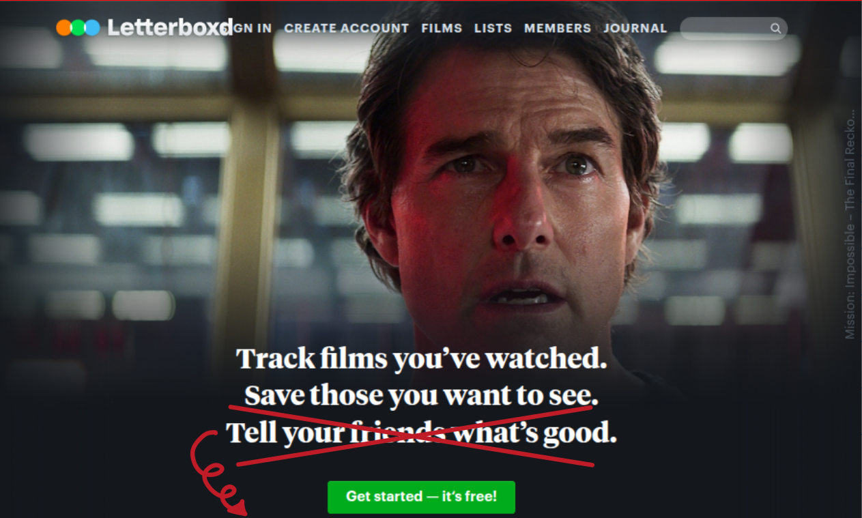
Phase 1:
Gathering Data
Tehran University
Data Science
In this Project 3 classes of data is scraped from letterbox website:
Tell us what’s good, We will find you friends!
Movies features:
Director, composer, cast, production year, genre, cast,...
Users features
Rating to their Favorite casts, directors, decade, genres, languages, countries,..
Watch count of casts, directors,....
Users rating to movies

Slide 6
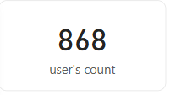
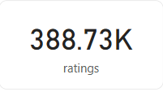
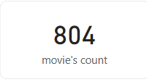
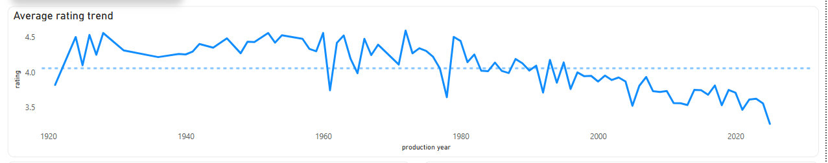
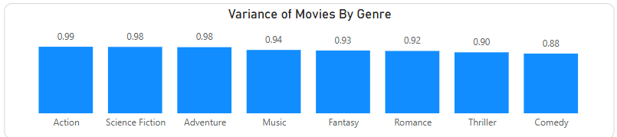
Some Visualizations

Slide 7
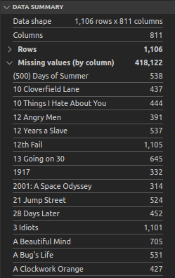
Phase 2:
Preprocessing Data
Tehran University
Data Science
Too many values missing !!
Preprocessing steps:
Handling missing values
Missing values in ratings
Missing values for low-activity users
Solution: Reshaping data to become suitable for models input

Slide 8
Data Structures!
Original Structure: Tabular
user_1 | actor_1_rating | actor2_rating | Actor3_rating ,....
user_2
user_3
Lots of Missing, Too big to give to the model !!

Slide 9
Data Structures!
Tehran University
Data Science
Spring 2025
Secondary Structure: Using pairs
(User1 , Cast1, Rating1_1)
(User1, Cast2, Rating1_2)
.
.
.
.
.
.
(User2, Cast1, Rating2_1)
Memory efficient, Hard to give to the model!

Slide 10
Data Structures!
Tehran University
Data Science
Spring 2025
Final structure: Repeating indexes in and Corresponding rating 10 times for each user.
 | Cast id_1 | Cast id 2 | Cast id 3 | …. | …. | Cast id 10
User 1 |  |  |  | …. | ….
User 2 |  |  |  | …. | ….

Slide 11
Phase 2:
Preprocessing Data
Tehran University
Data Science
Spring 2025
Preprocessing steps:
Handling missing values
Missing values in ratings
Missing values for low-activity users
Feature engineering
Encodings & Normalizations

Slide 12
Phase 3:
Designing and Training models
Tehran University
Data Science
Spring 2025

Slide 13
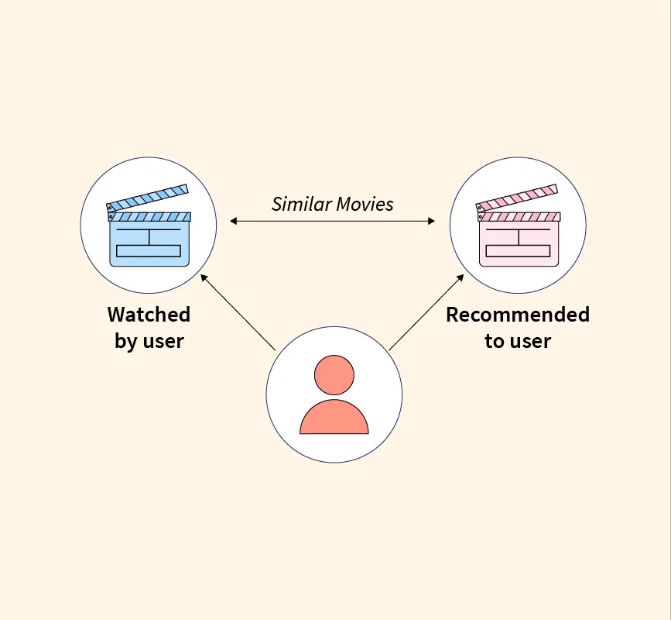
Models Definitions
Tehran University
Data Science
Spring 2025
Here is a brief description about our models:
Core model
Autoencoder
Content based filtering neural network
KNN
Used to create an encoding of movies and users data
Using encoded data to predict user’s rating to movies
This model finds people near each by the encoding offered by content based filtering neural net

Slide 14
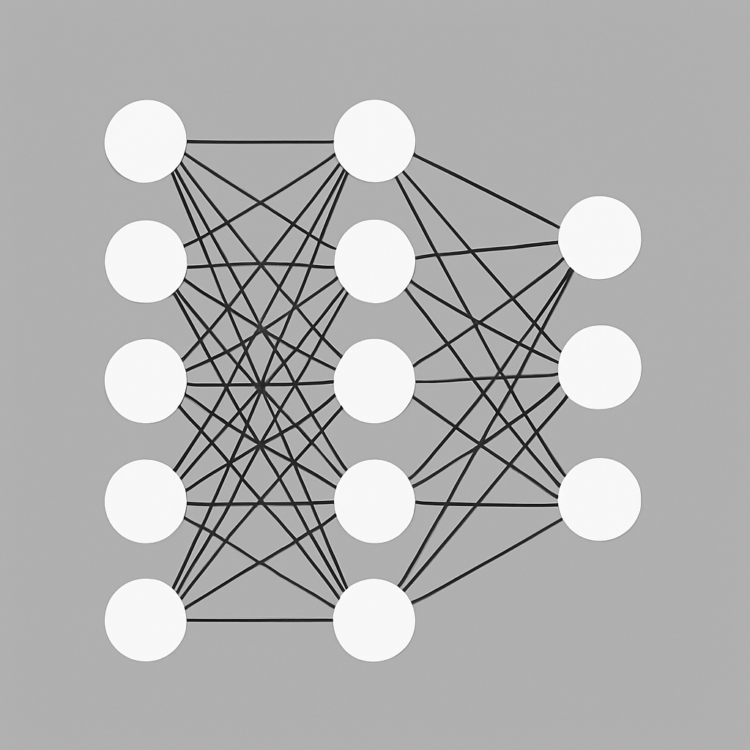
Models Specifications:
Embedding layers
Movies Autoencoder
Directors, cast,... IDs
Other features(Genre, duration, production year)
Rating
Dot product
Cast,Directors... ratings
*
Cast,Directors... IDs
Embedding layer
Encoded Users

Slide 15
Phase 4:
Results
Tehran University
Data Science
Spring 2025

Slide 16
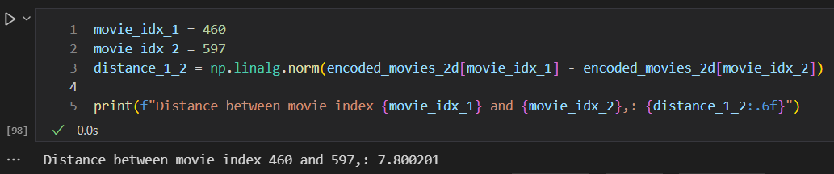
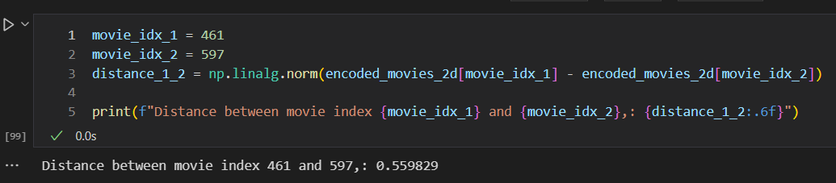
Movie Encoder Model results:
Tehran University
Data Science
Spring 2025
Model calculation for distance between dissimilar movies(Batman and Godfather I):
Model calculation for distance between dissimilar movies(Godfather I and Godfather II):

Slide 17
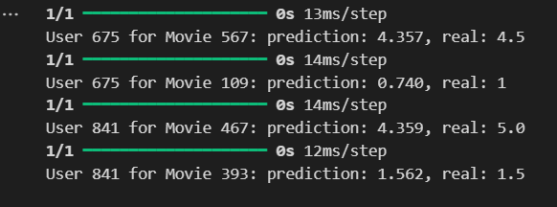
Content Based Filtering Results:
Tehran University
Data Science
Spring 2025
Models Prediction for user rating to movies:

Slide 18
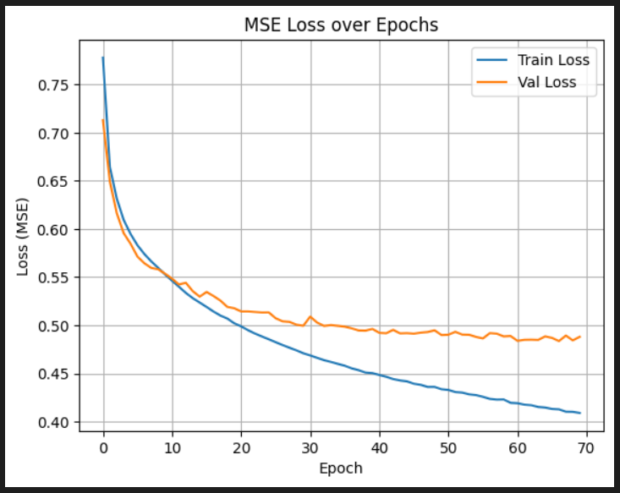
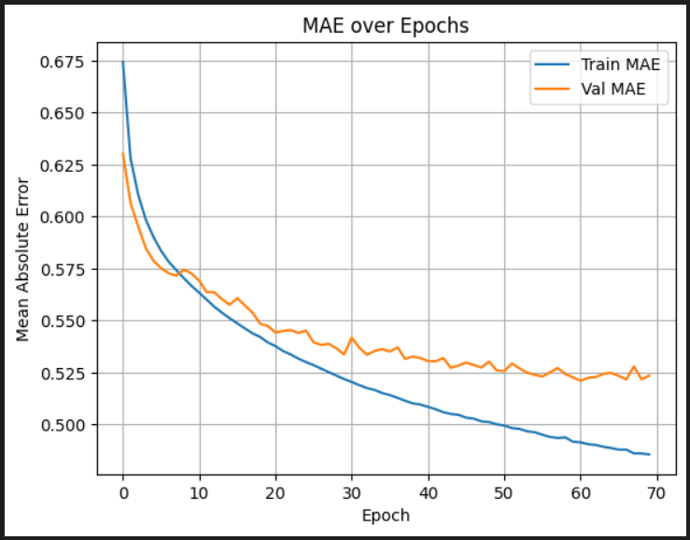
Model Train and Validation result:
Tehran University
Data Science
Spring 2025

Slide 19
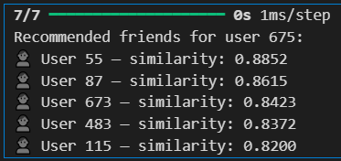
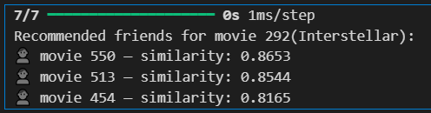
Sample output of KNN model:
Tehran University
Data Science
Spring 2025
For Users:
For movies:
Movie 550: The Prestige
Movie 513: The Martian
Movie 513: War for the Planet of the Apes

Slide 20
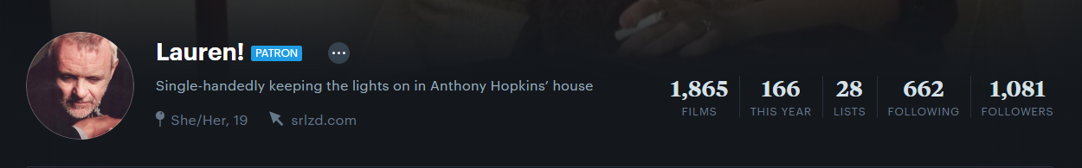
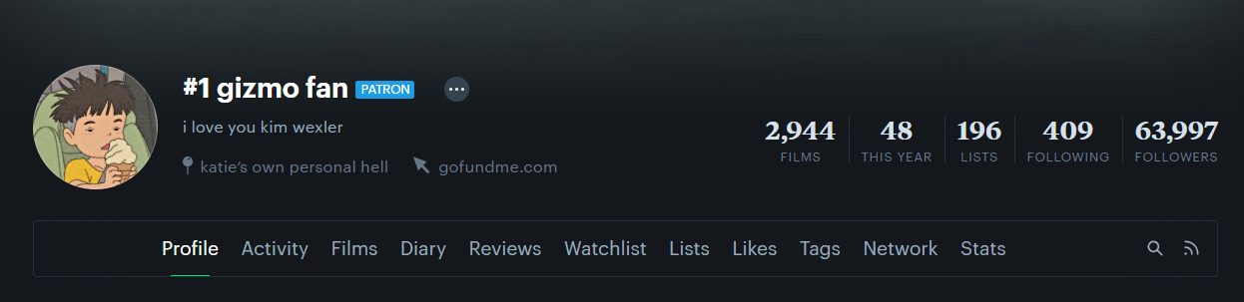
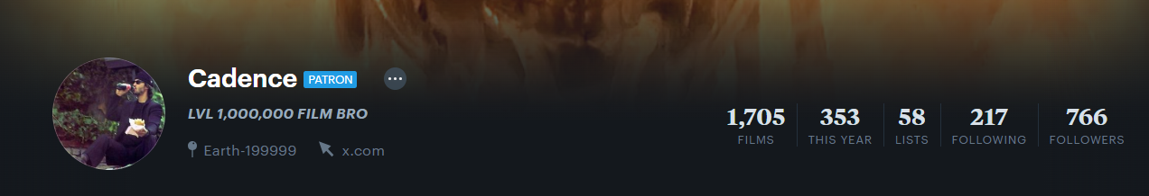
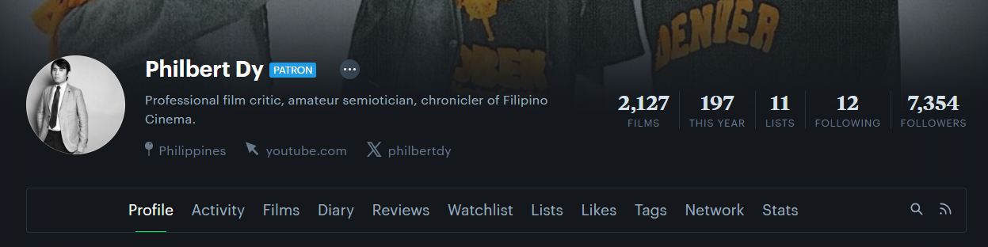
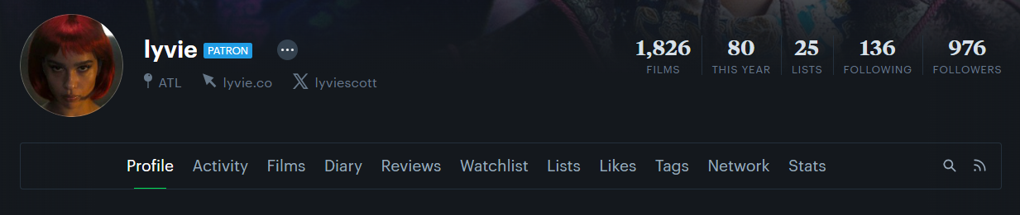
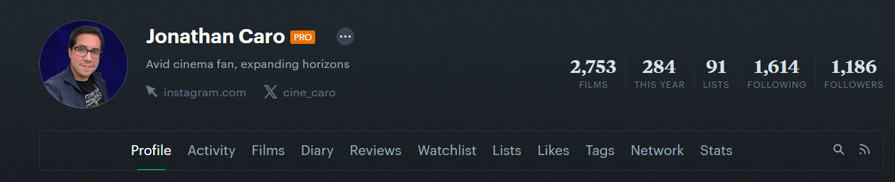
Sample recommended friends :)
Tehran University
Data Science
Spring 2025

Slide 21
Thank you
Company Name
Quarter
Month Year

